Slide 1

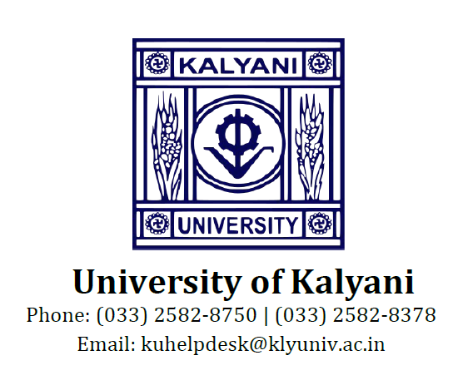
BlockVote: Blockchain Based E-Voting System
COLLEGE: KALYANI MAHAVIDYALAYA
SEMESTER: 6TH SEMESTER
PAPER CODE: UG-H-DSE-PRO-604
Presented by
ROLL No. 2116117-1915793 (Regn no. 015438 of 2019-2020)
ROLL No. 2116117-1915688 (Regn no. 015424 of 2019-2020)
Submitted for the partial fulfillment of B.Sc. Honors In Computer Science.
Year of Submission: 2022

Slide 2
INTRODUCTION
Modern democracies are built upon traditional ballot or electronic voting (e-voting). In these recent years, devices which is known as EVMs are hugely criticized due to irregular reports of the election results. There have been many questions regarding the design and internal architecture of these devices and how it might be susceptible to attacks. This paper has analysed different techniques of tampering the EVMs. Online-voting is pushed as a potential solution to attract the young citizens and the non- resident of the country. For a robust online election scheme, a number of functional and security requirements are to be met such as transparency, accuracy, auditability, data privacy, etc.
We have worked the following ideas by having the two different set of modules: election commission and the voter(s). Election Commission creates elections and adds registered candidates along with the parties for contesting the election. Using an election’s REST API hosted on Ethereum’s Blockchain, the details are shown at the front-end of the voter for casting the vote. Then, while polling the vote is stored on our blockchain framework of which the Election Commission fetches the vote count. The limitation which we have faced due to not using the traditional way of smart contracts is that the blockchain framework which we have coded cannot run on the main net as it needs to be hosted and a separate web3 provider have to be used for interacting with it and not having a public API of voter ID creates a drawback of not having authentication of a voter.
The most important factor of this application is to integrate the blockchain framework with both the modules for seamless voting.

Slide 3
Objectives
The objectives for developing the project are as follows:
• To improve the existing online voting system using Blockchain technology.
• To reduce the workload of setting up an election booth and conducting election sin physical form.
• Non-Resident Indian can cast their votes as it is totally online.
• We are supposed to learn the concept of Blockchain and how it can be utilized to work on different sectors.
Product Features
Eligibility: This property states that only eligible users can vote. Those who are provided with authentication by the Election Commission.
Privacy: Privacy is one of the most important aspects of democratic voting. Voters privacy should be maintained. No one should be able to know how a particular person voted or to whom the particular voter voted.
Coercion resistance: No one should be able to force the voter and should not have the ability to distinguish between whether the voter voted the same way he/she was instructed to vote.
Verifiability: This property states that everyone involved in the voting process should be able to verify the results. This brings transparency in the election. Also, an individual voter should be able to verify whether his/her vote is counted or not.
Immutability: The voter's vote should be immutable. No one should be able to change the vote of any voter without proper concern of the voter. All the records should be immutable.

Slide 4
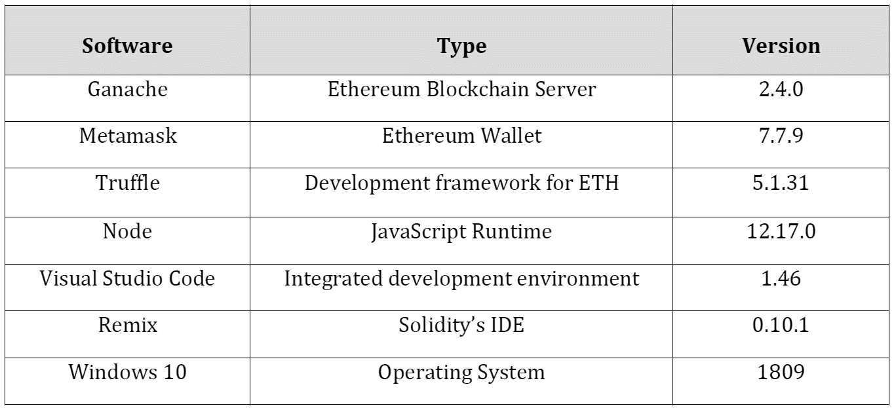
Hardware Specification
Software Specification
Processor | Intel Pentium 4 or later
RAM | 2 GB or higher
Cache | 512 KB or above
Required Space | 10 GB
Input Device | Mouse & Keyboard
Output Device | Monitor

Slide 5
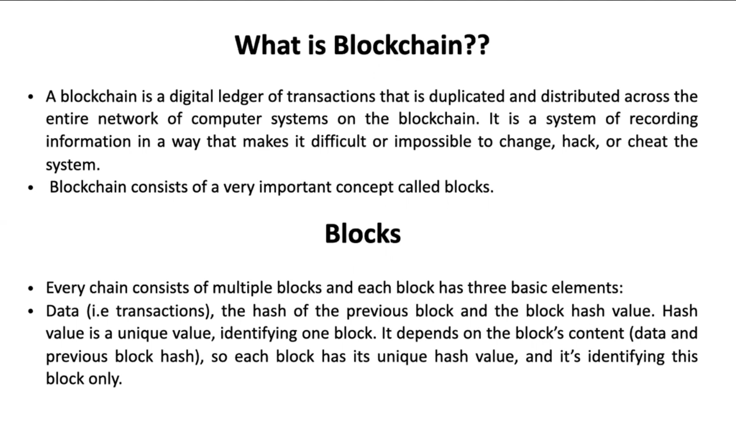
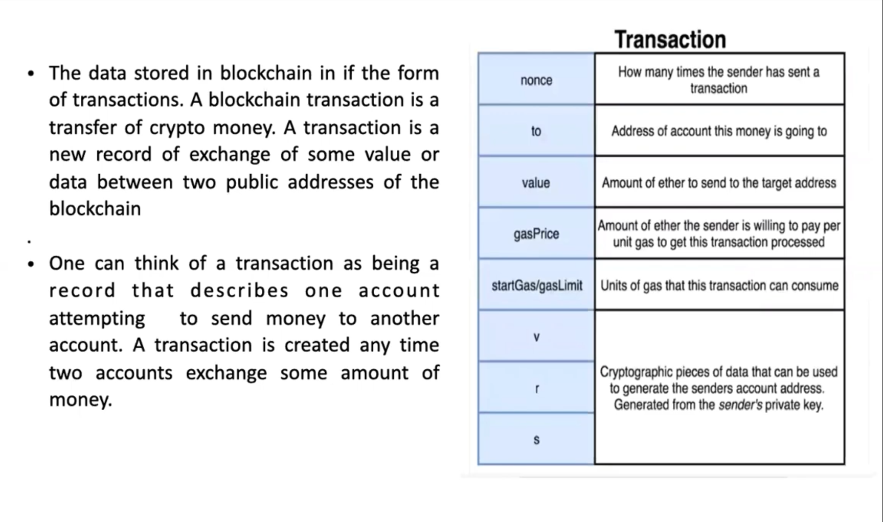
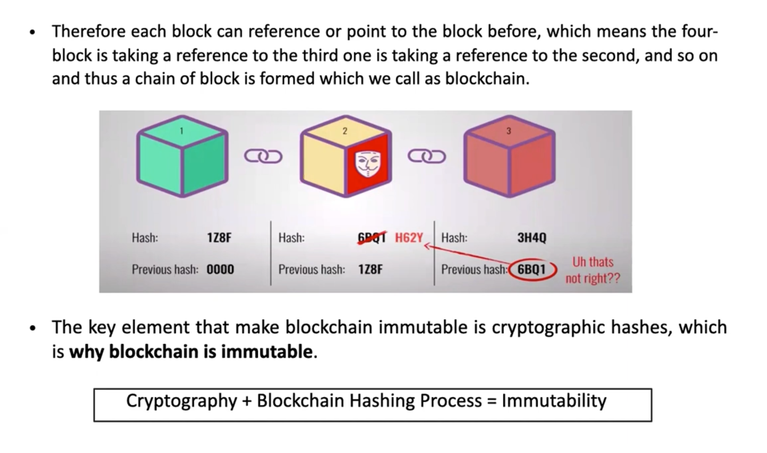

Slide 6
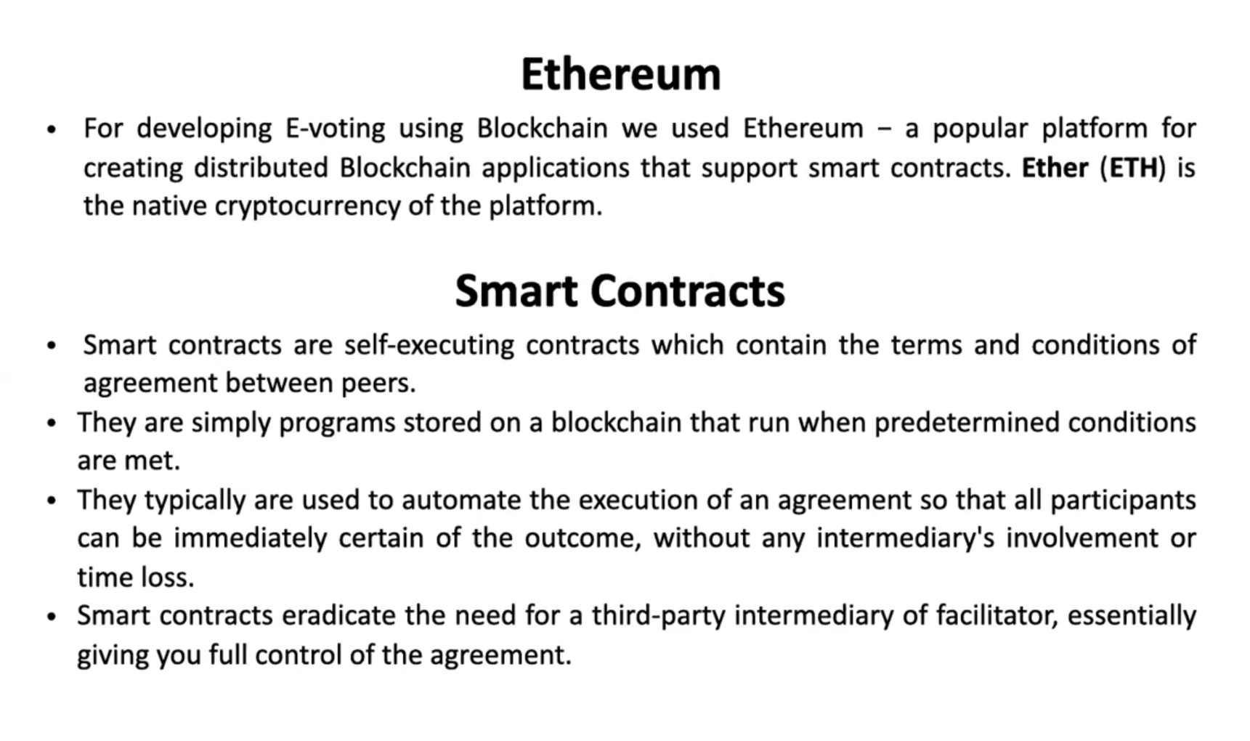
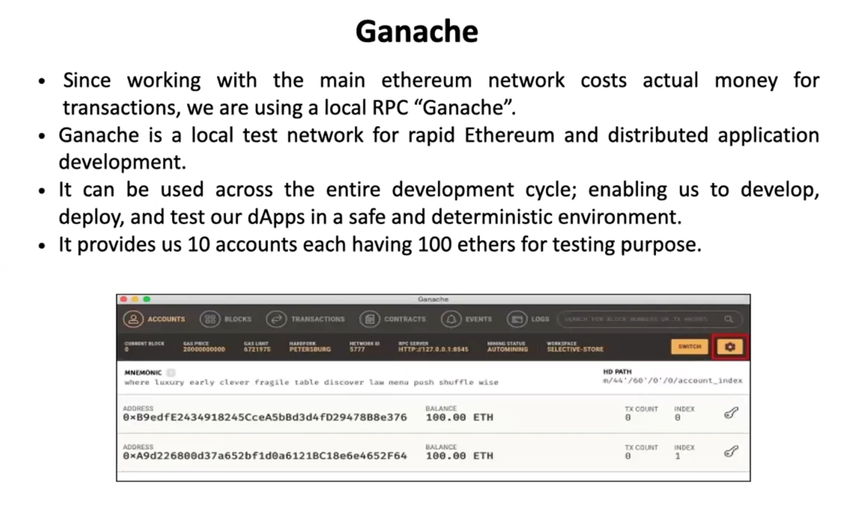
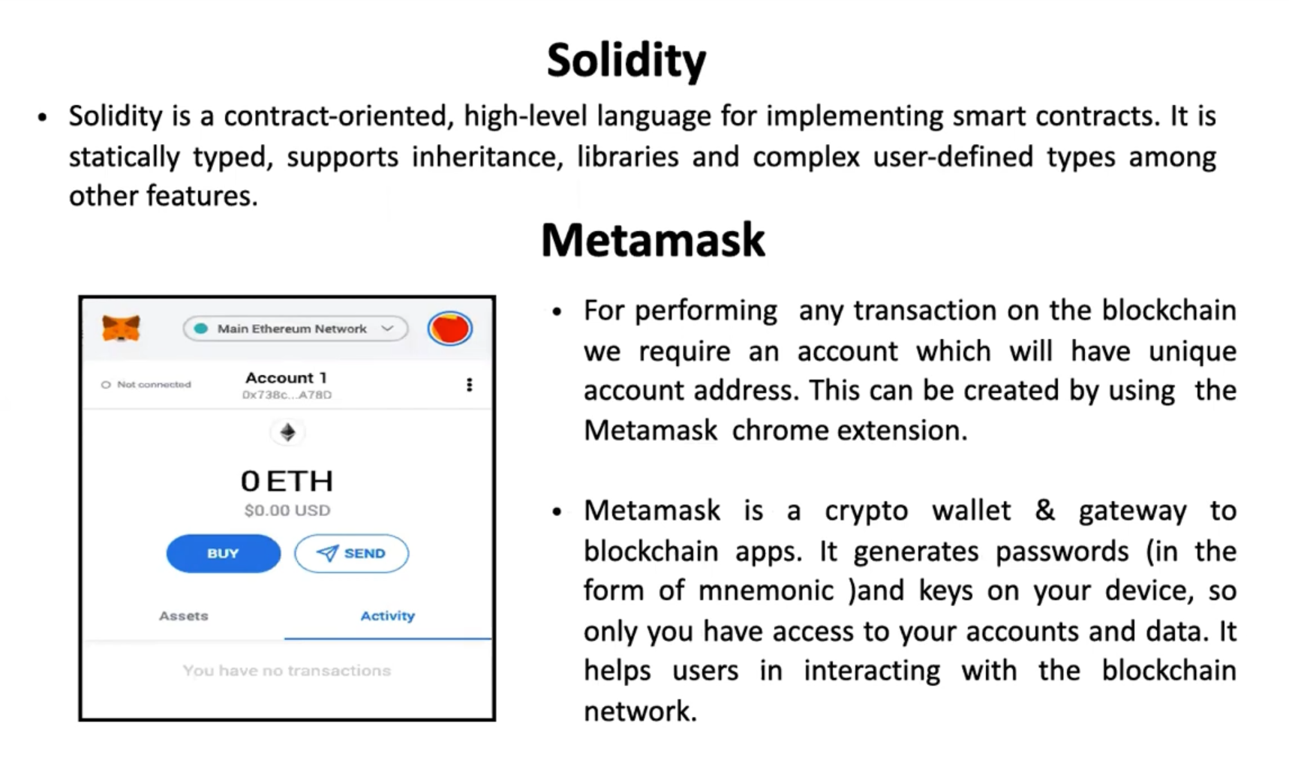
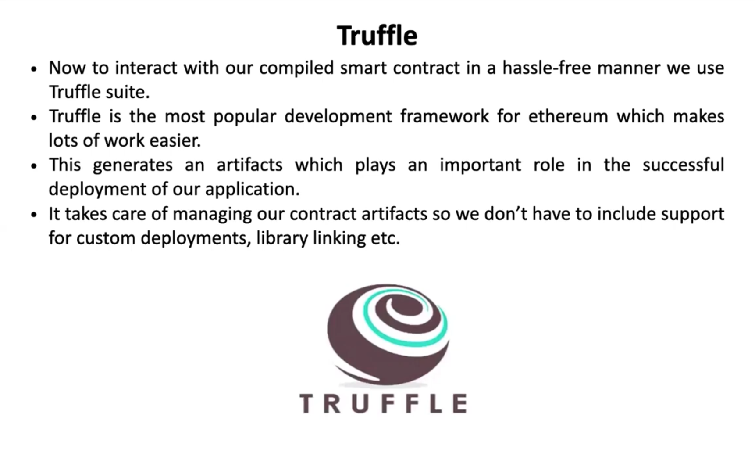

Slide 7
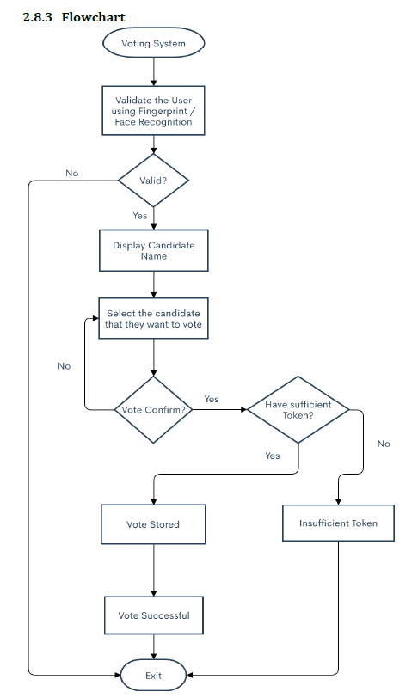
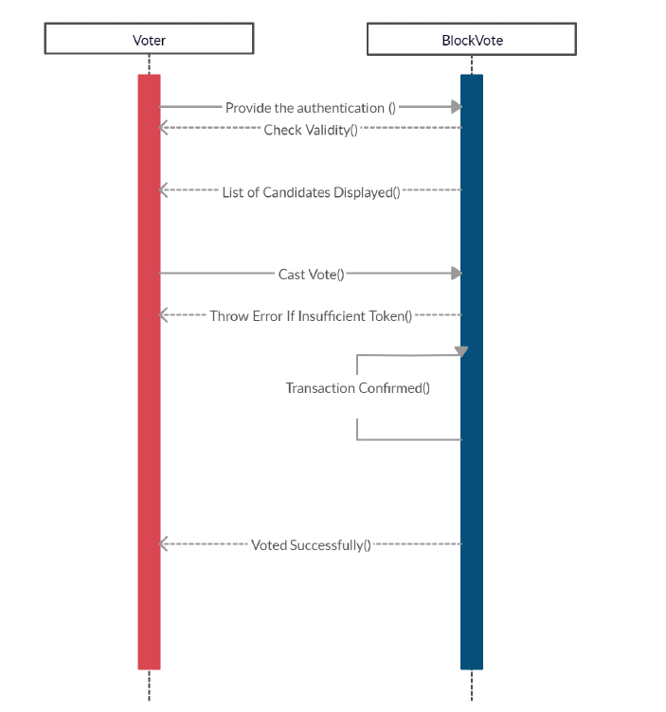
Flow chart
Sequence Diagram

Slide 8
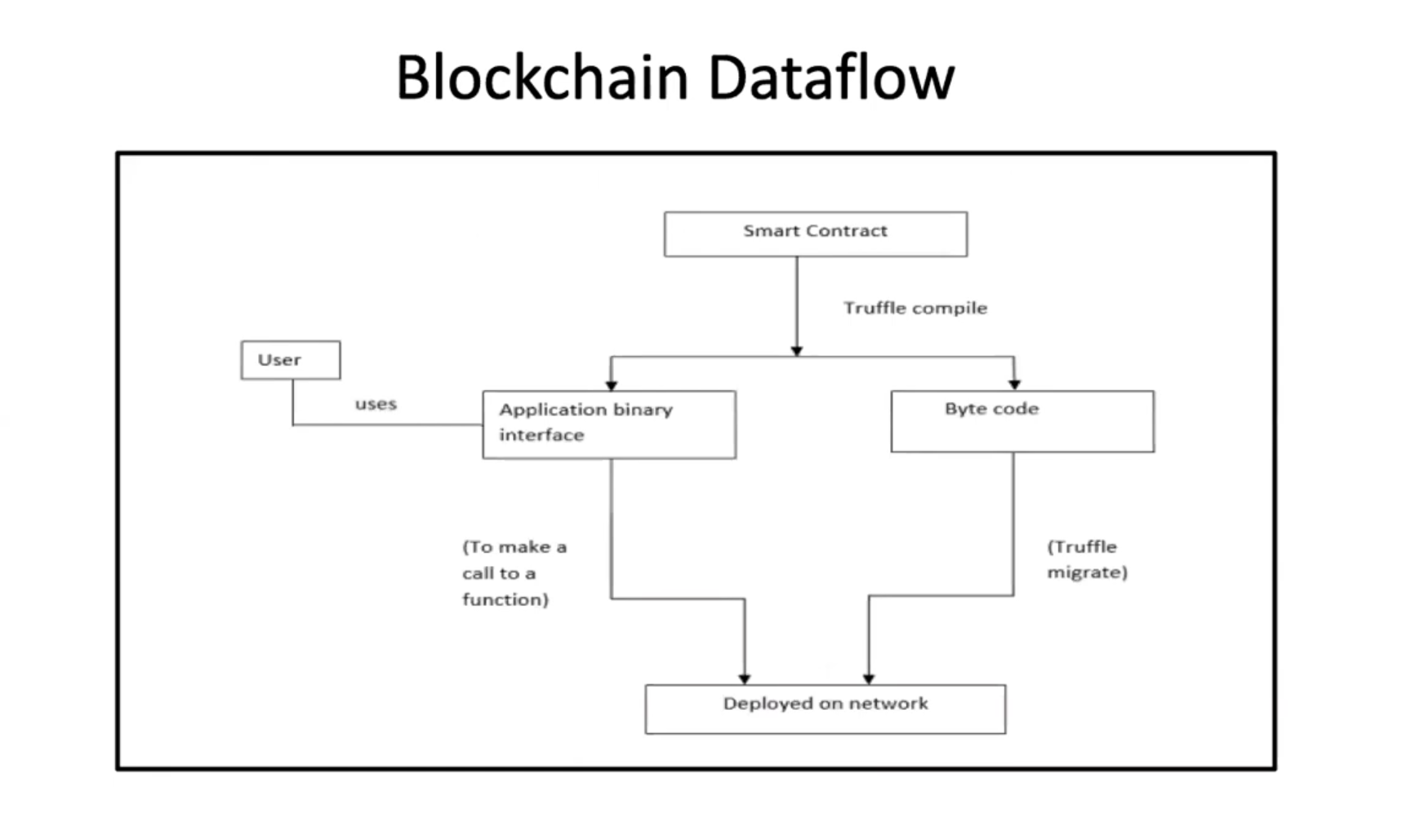
Dataflow Diagram

Slide 9
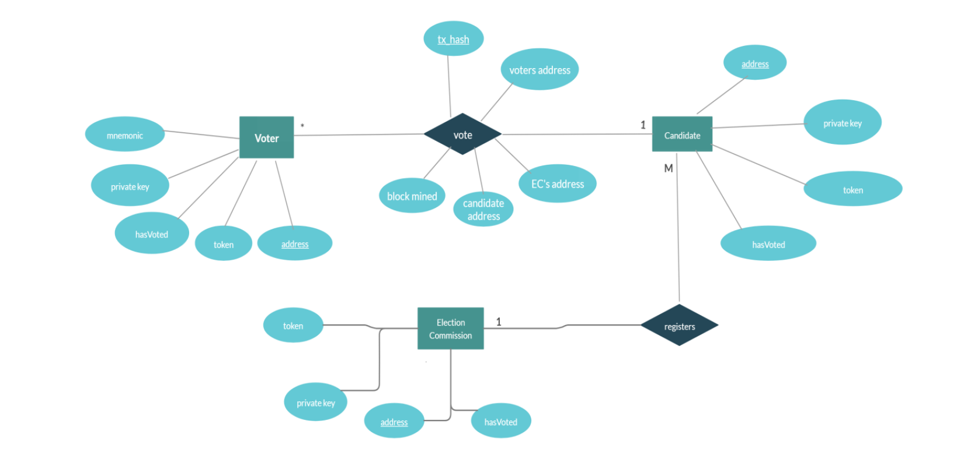
ER Diagram

Slide 10
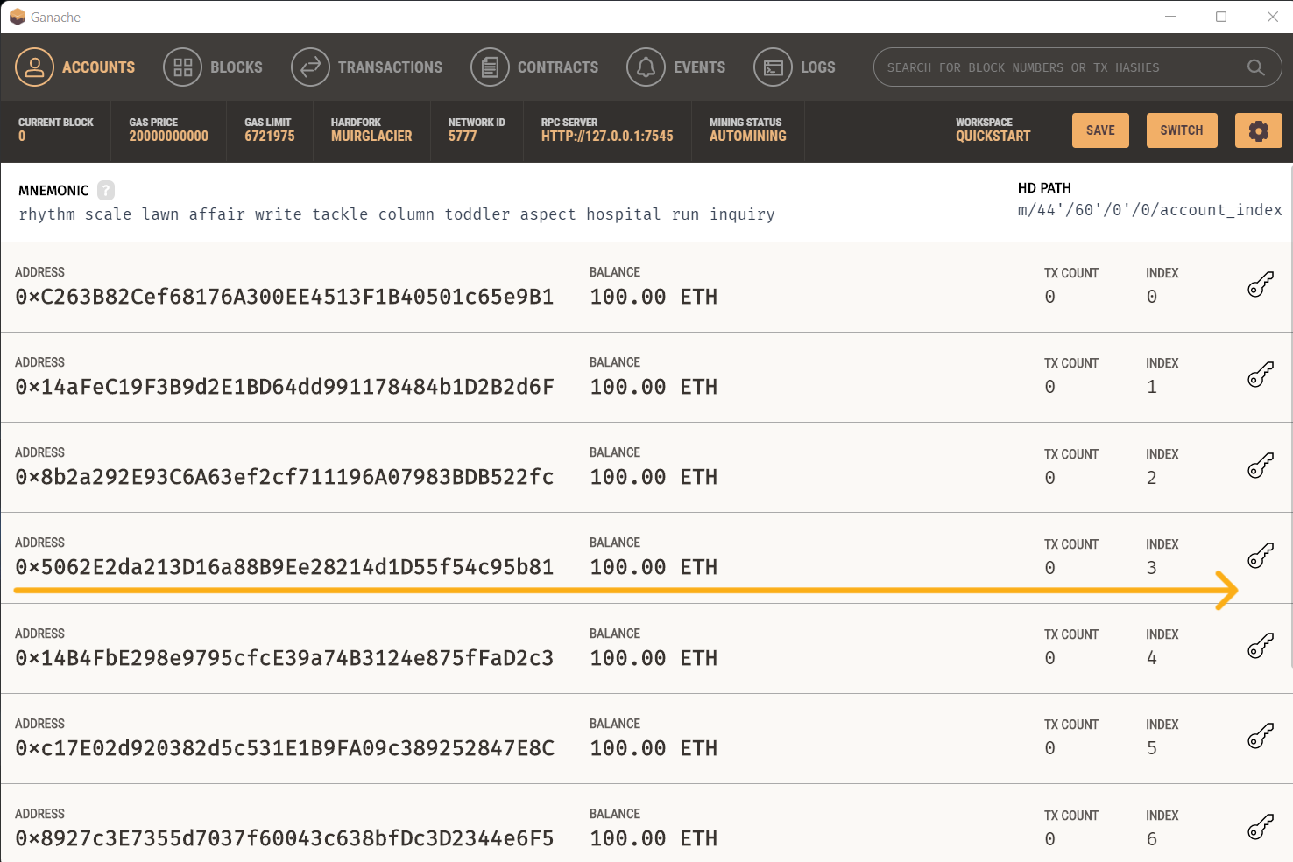
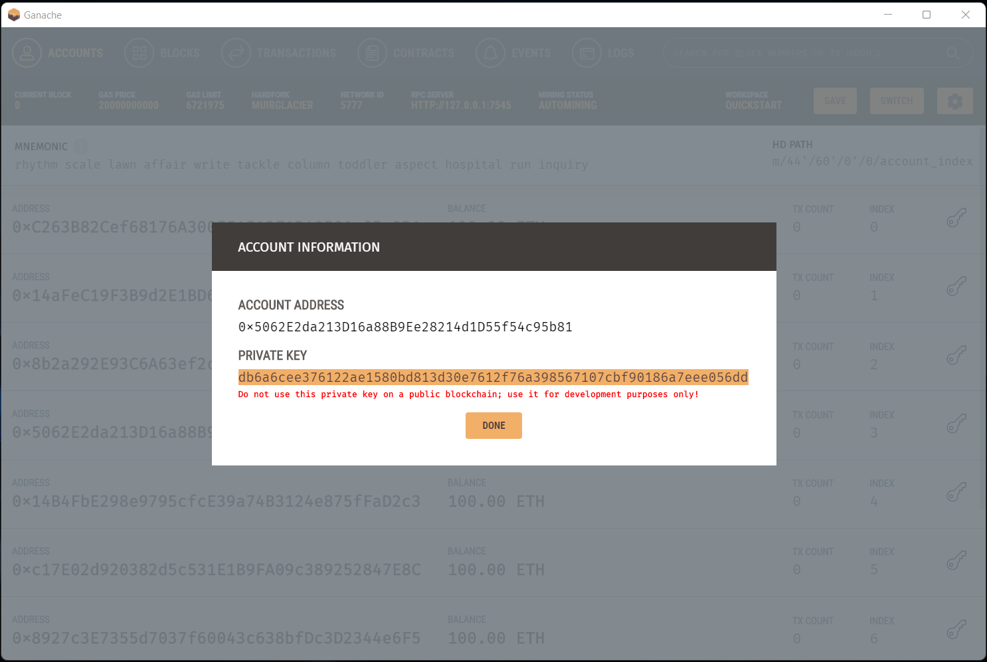
Screenshots
Step 1: find voter id
Step 2: copy voter id

Slide 11
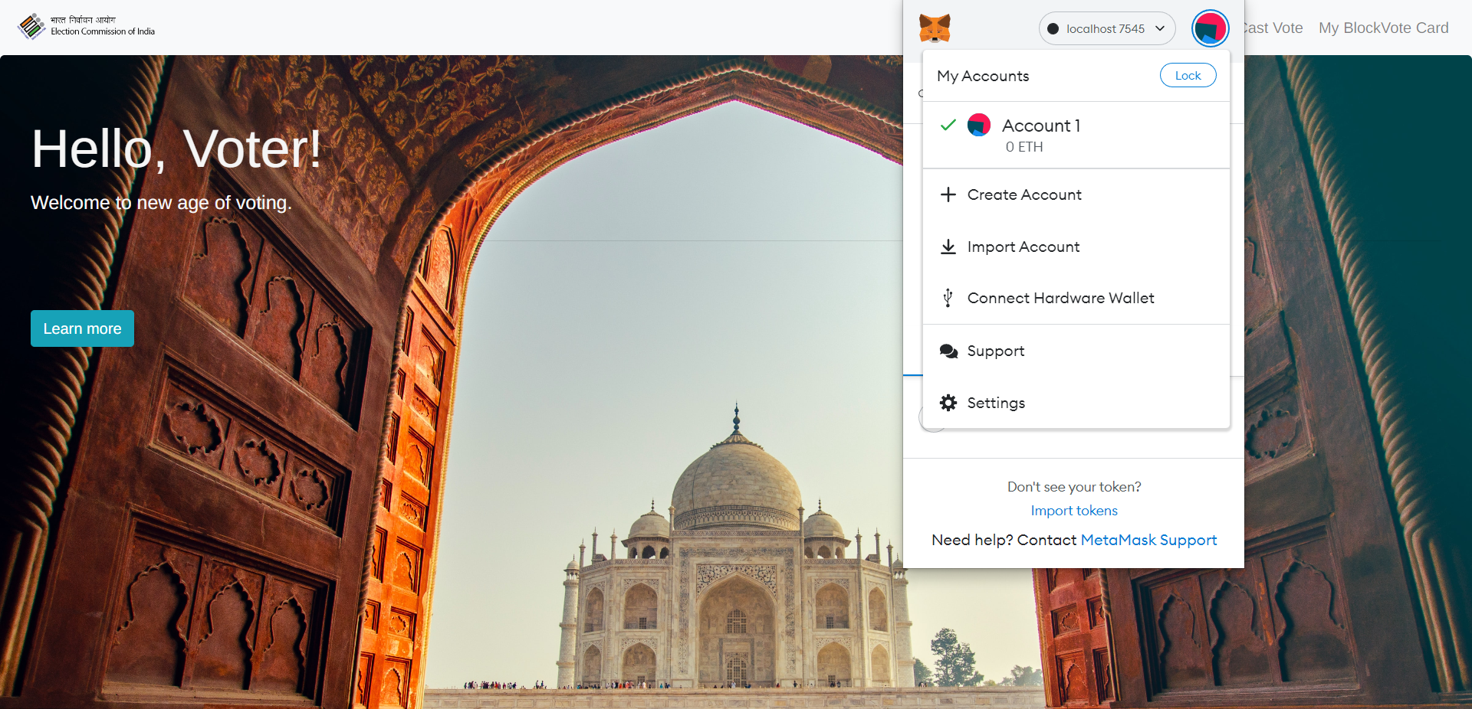
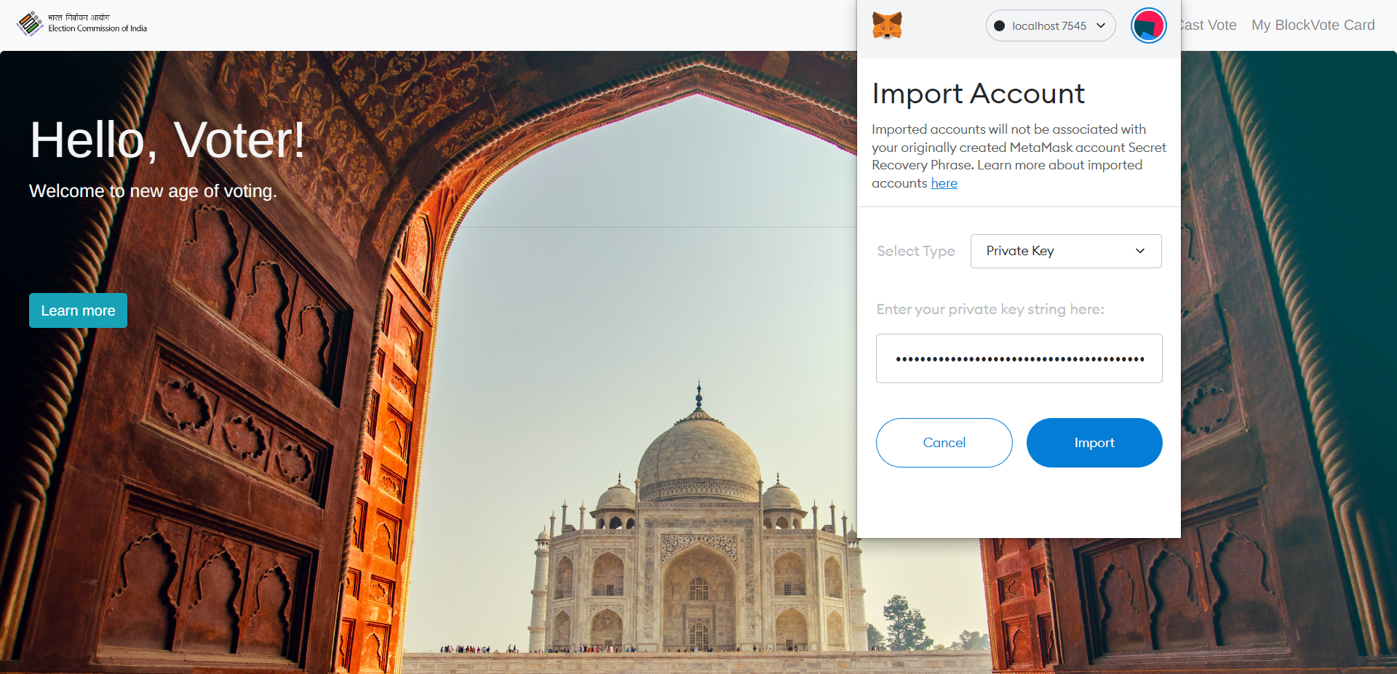
Step 3:
Open metamask
Step 4:
Add voter id

Slide 12
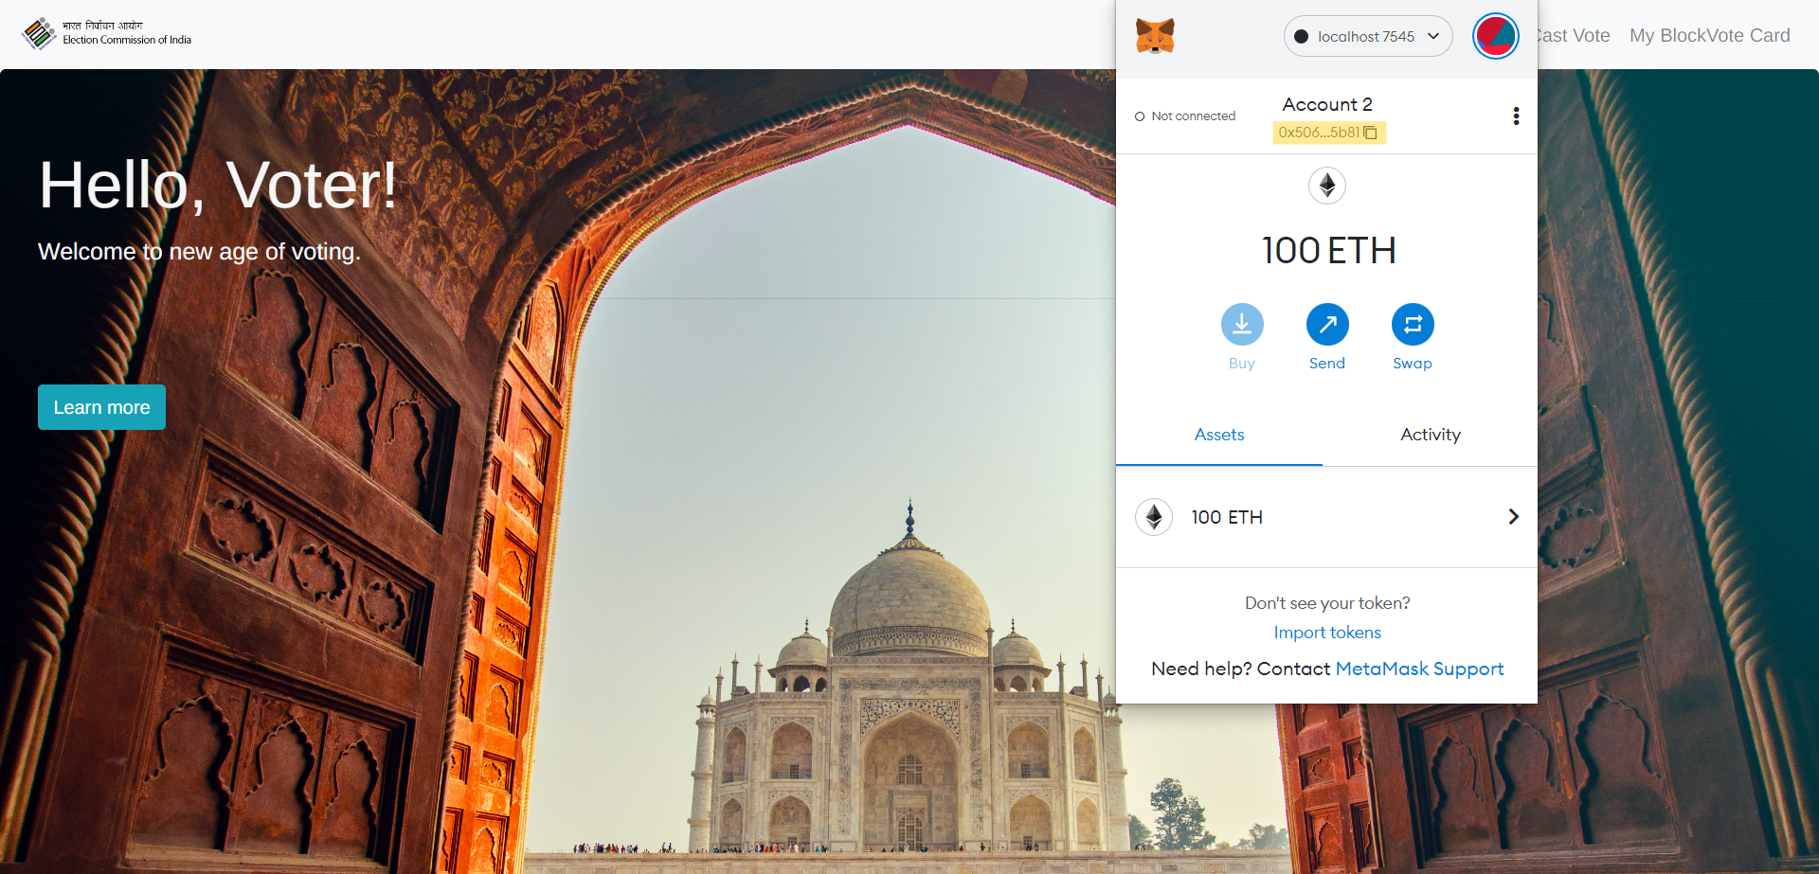
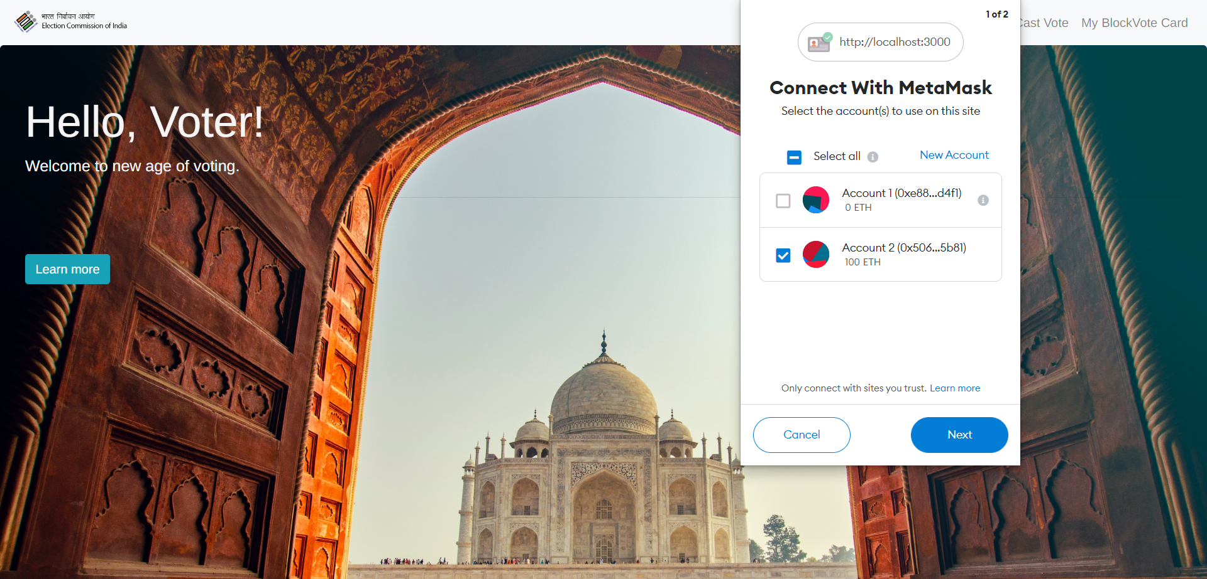
Step 5:
Account added
Step 6:
Connect for voting

Slide 13
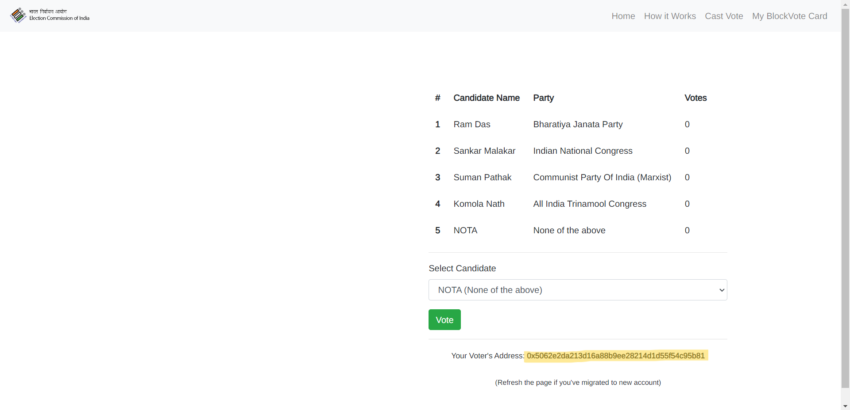
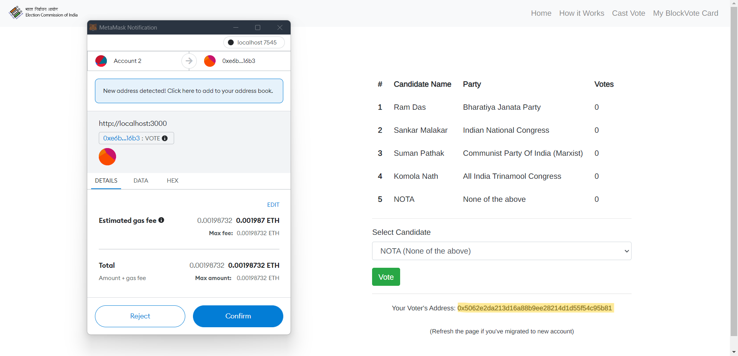
Step 8:
Cast vote
Step 9:
Transaction

Slide 14
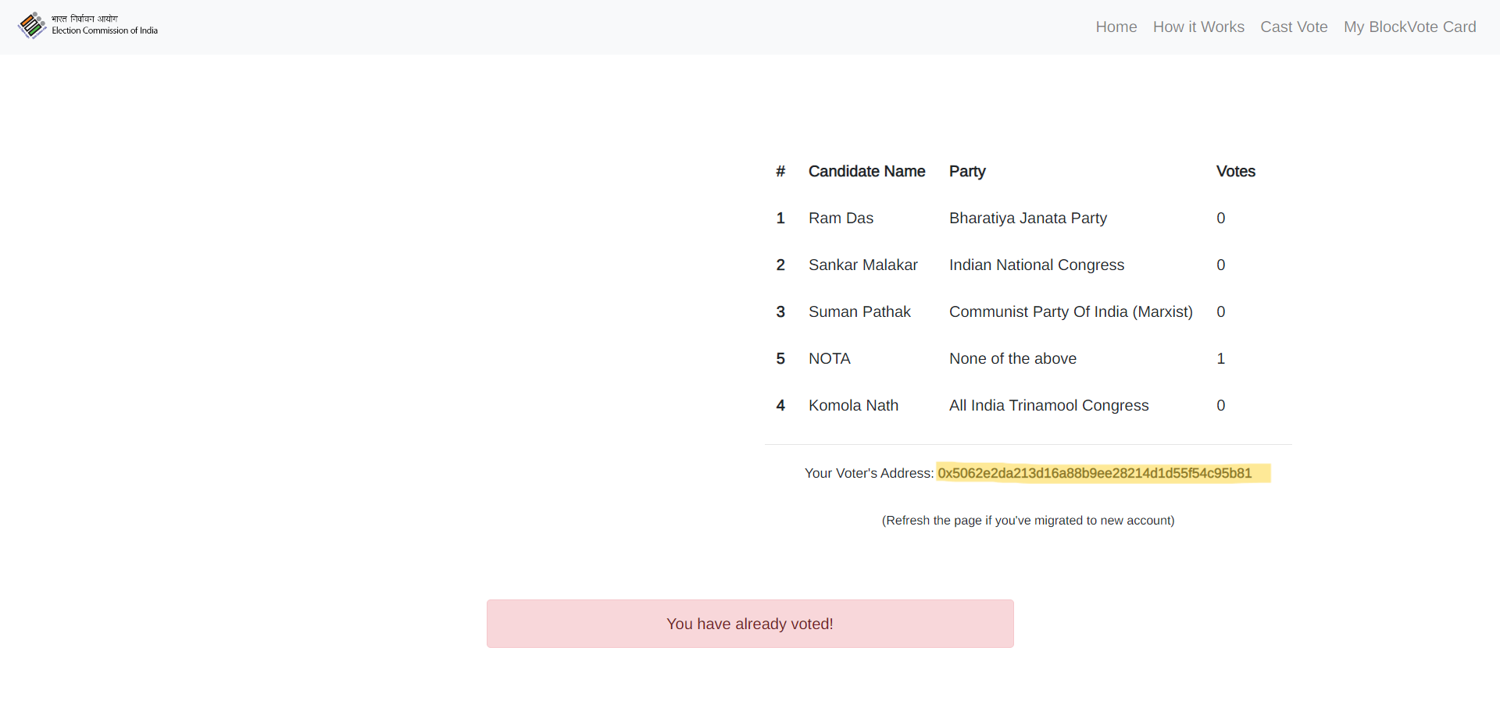
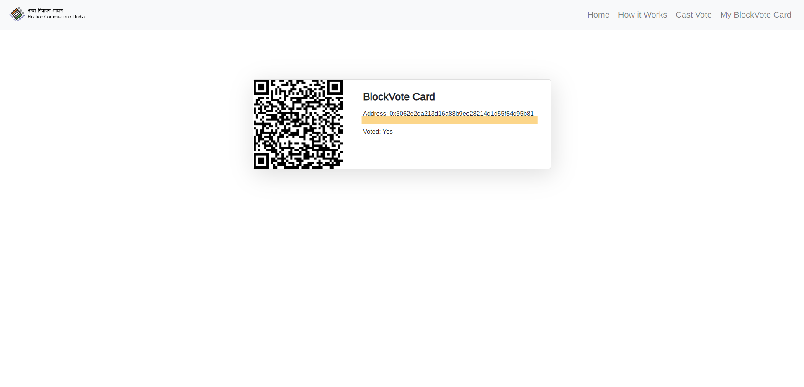
Step 10:
Vote successful
Showing Voter id:

Slide 15
CONCLUSION
Democracies depend on trusted elections and citizens should trust the election system for a strong democracy. However traditional paper-based elections do not provide trustworthiness. The idea of adapting digital voting systems to make the public electoral process cheaper, faster and easier, is a compelling one in modern society. Making the electoral process cheap and quick, normalizes it in the eyes of the voters, removes a certain power barrier between the voter and the elected official and puts a certain amount of pressure on the elected official. It also opens the door for a more direct form of democracy, allowing voters to express their will on individual bills and propositions.
This project has been developed to a blockchain-based electronic voting system that utilizes smart contracts to enable secure and cost-efficient election while guaranteeing voters privacy. It outlines the systems architecture, the design, and a security analysis of the system.
In the next build of this application, it has been proposed to create separate client designs for various roles such as one for election commission and one for candidates registered to a certain party with the existing voting client design. Also, the current versions lack authentication as we don’t have access to current Aadhar’s or Voter SDK to integrate in our application. Also, it is planned that in the next build notification prompt will be given on the day of voting to all the voters to cast their vote so that the voter turnout is maximum for that election.
References
[1] Wolchok, Scott, et al. "Security analysis of India's electronic voting machines." Proceedings of the17th ACM conference on Computer and communications security. ACM, 2010.
[2] Ohlin, Jens David. "Did Russian cyber interference in the 2016 election violate international law."Tex. L. Rev. 95 (2016): 1579.
[3] Ayed, Ahmed Ben. "A conceptual secure blockchain-based electronic voting system." InternationalJournal of Network Security & Its Applications 9.3 (2017): 01-09.
[4] Hanifatunnisa, Rifa, and Budi Rahardjo. "Blockchain based e-voting recording system design." 201711th International Conference on Telecommunication Systems Services and Applications (TSSA). IEEE,2017.
[5] Yu, Bin, et al. "Platform-independent secure blockchain-based voting system." InternationalConference on Information Security. Springer, Cham, 2018.

Slide 16
Thank You.

